Slide 1

Content Based Image Retrieval
Team Members -
Bhavana Kurra
Vijayasimha Bheemireddy
Rachana Reddy Podduturi

Slide 2
Contents
Problem Statement
Background
Architecture
Methodology
Result
Summary

Slide 3
Problem Statement
Building a Machine Learning model which displays the most relevant image in the user database for a given input image using transfer learning.

Slide 4
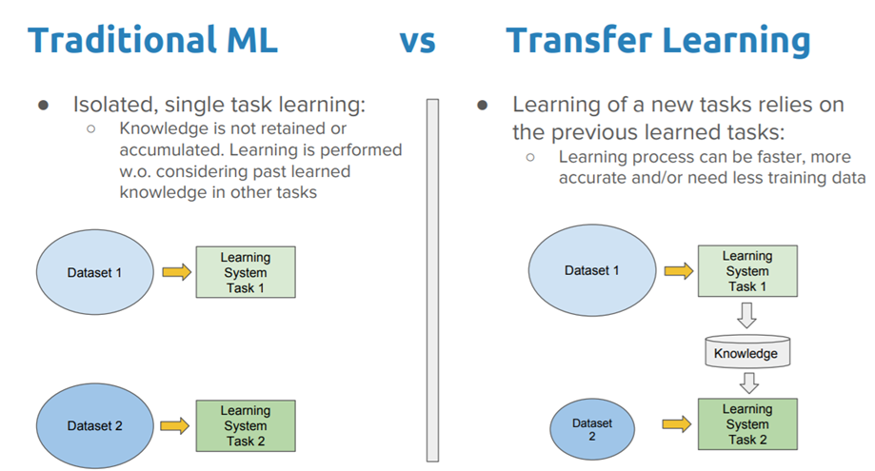
Background - Traditional Machine Learning vs Transfer Learning
Traditional Machine Learning creates a separate model for each dataset/task.
Transfer learning stores the knowledge gained while solving one problem and applies it to a different but related problem.

Slide 5
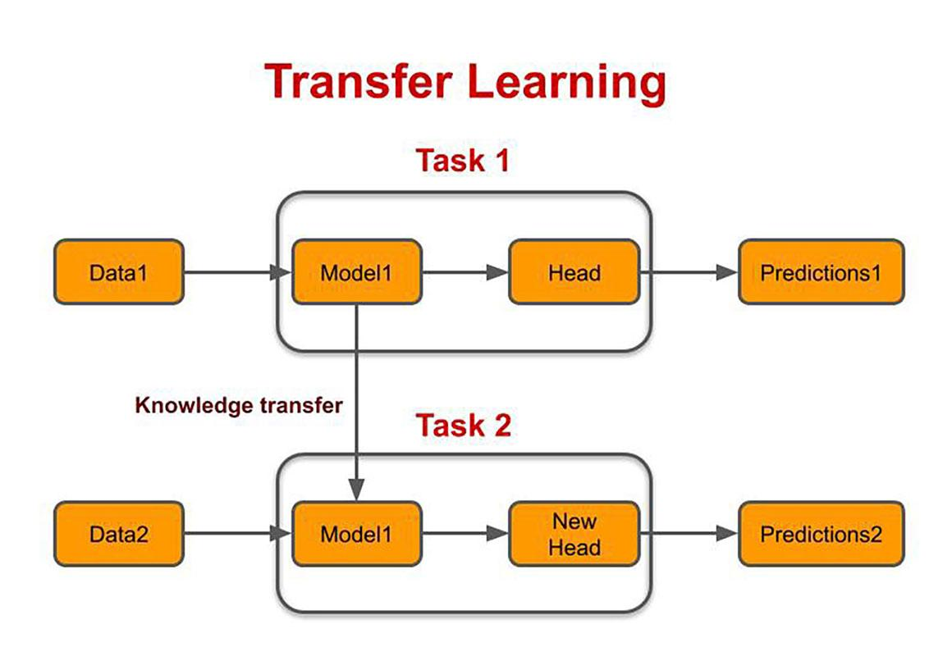
Background - How are we using transfer learning in this project?
The data1 is the ImageNet dataset.
The Model1 is VGG(Visual Geometry Group)-16 model
Task1 is ImageNet dataset classification
The data2 is the Database 2(local database) that we created.
Task 2 is Image Retrieval from the Database1(local database).

Slide 6
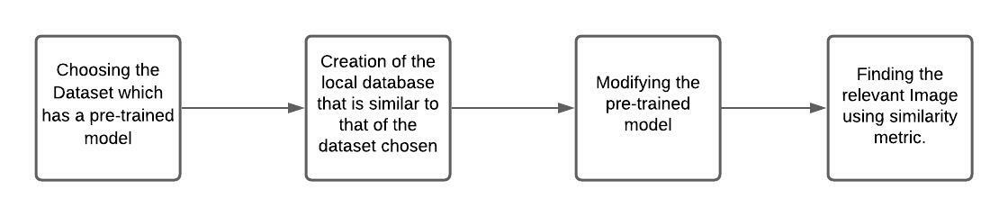
Architecture / Steps to be followed -

Slide 7
Methodology
Step 1 - Choosing the Dataset which has a pre-trained model
We have chosen the ImageNet dataset which has AlexNet, VGGNet, Inception, ResNet, Xception etc as the pre-trained models over it.
Description about ImageNet Dataset -
ImageNet is a dataset of over 15 million labeled high-resolution images belonging to roughly 22,000 categories.
ImageNet Large-Scale Visual Recognition Challenge (ILSVRC) uses a subset of ImageNet with roughly 1000 images in each of 1000 categories.
Overall, there are roughly 1.2 million training images, 50,000 validation images, and 150,000 testing images

Slide 8
Methodology
Step 2 - Creation of the local database that is similar to that of the dataset chosen.
We have created a local database with a set of images from different categories that are similar to the ImageNet dataset but that don’t exactly belong to the classes that exist in the ImageNet dataset.
We have created a local database of 245 images. We have divided the local database into the two databases -
Database1 - The database which has the images for which we extract and store the features using the pre-trained model for future usage.
Database2 - The test database which has the images that we compare to that of the images in the Database1 to evaluate the pre-trained model performance.
The Database1 has 195 images in total and the Database 2 has 50 images in total.
We have 25 image categories in our local database(Database1 and Database 2 together).

Slide 9
Methodology - Need for the creation of a local database?
Our task is to retrieve the top 3 most similar images in our database(Database1) for a given query image(All the images in the Database 2).
That is, we have to create an Image Retrieval model using the knowledge gained by the VGG-16 model while trying to classify the ImageNet dataset.
For the Image Retrieval model creation, we have created the Database 1 and Database 2 as a part of local database.

Slide 10
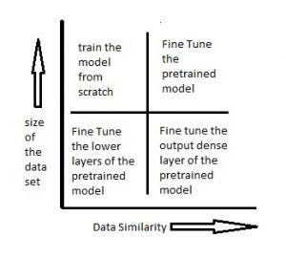
Methodology
Step 3 - Modifying a Pre-trained model
We have chosen the VGG-16 model among all the pre-trained models of ImageNet dataset.
In order to modify the pre-trained model, We have considered the local database similarity to that of the ImageNet dataset and the size of the ImageNet dataset.
Since our local database images are similar to that of the ImageNet database and ImageNet has 1.4 million images in total, we have opted for the ‘Fine Tuning the pre-trained model either by the output dense layer or by the higher dense layers’ option.
We have used the higher dense layer(i.e the layer before applying the softmax function) to extract features.

Slide 11
Methodology
Step 4 - Finding the relevant Image using similarity metric
We need a similarity metric to retrieve the relevant images from our local database(Database1) for a given query image.
We have used the “Cosine Similarity” as the similarity metric in order to compare the query image(i.e, Any image from the Database2) to that of the images for which we have extracted and stored the features(i.e, All the images in the Database1).

Slide 12
Result
There are 50 query images in the Database 2. For a given query image we get top 3 relevant images so on total we got 150 images. Out of 150 results, 11 images don’t belong to the query image class and 139 images are correctly retrieved.
The accuracy of this model is 92.66% i.e., (139/150)*100.

Slide 13
Summary
We have extracted and stored the features for all the images in the Database 1 using VGG-16 model.
Then for a given query image(i.e all images in database 2), we have extracted features and compared(using cosine similarity) those features to all the images features that are stored earlier to find the top 3 relevant images.
Results are stored into a file from which we have calculated the accuracy of our model.

Slide 14
Thank you

